Slide 1
CS5220 Advanced Topics in Web Programming
Spring – Web MVC
Chengyu Sun
California State University, Los Angeles

Slide 2
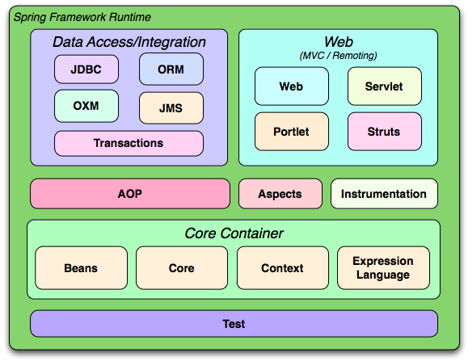
Spring Framework

Slide 3
The SpringMVC Example
Spring and Hibernate from Scratch
  http://csns.calstatela.edu/wiki/content/cysun/course_materials/cs520/sham/

Slide 4
Add Spring MVC to A Maven Webapp
Spring dependencies
  spring-webmvc
Front controller
  DispatcherServlet in web.xml
Bean configuration file
  /WEB-INF/<servlet-name>-servlet.xml

Slide 5
Request Processing in Spring Web MVC
Controller
URL
Mapping
URL
Mapping
Controller
Request
Controller
Front
Controller
Controller
Application Server
model
Response
View
View
Resolution

Slide 6
Spring Controllers
Spring controllers are beans annotated with @Controller
In <servlet-name>-servlet.xml
  <mvc:annotation-driven>
  <context:component-scan>

Slide 7
Controller URL Mapping
Requests are mapped to controller methods using @RequestMapping
  value: URL pattern(s)
  Mapping can be further refined by using method, params, and headers
  https://docs.spring.io/spring/docs/current/spring-framework-reference/web.html#mvc-ann-requestmapping

Slide 8
View
A controller method returns a view name, which will be resolved to a view implementation by a view resolver

Slide 9
Resolve JSP Views
<bean id="viewResolver"
class="org.springframework.web.servlet.view.InternalResourceViewResolver">
<property name="prefix" value="/WEB-INF/jsp/" />
<property name="suffix“ value=".jsp" />
</bean>
Prefix + ViewName + Suffix = JSP File
Why not just return the path to the JSP file??

Slide 10
View Technologies and Resolvers
https://docs.spring.io/spring/docs/current/spring-framework-reference/web.html#mvc-view

Slide 11
Model
Model objects are passed to view using a ModelMap
  put( String, Object )
attribute
name
attribute
value

Slide 12
Request Processing Recap
3
Controller
URL
Mapping
1
URL
Mapping
Controller
2
Request
Controller
Front
Controller
Controller
Application Server
5
model
4
Response
View
Resolution
View
6
7

Slide 13
Database Access Dependencies
Hibernate
Spring ORM
Database connection pooling
  DBCP vs. Tomcat JDBC
Database driver

Slide 14
Configuration
Hibernate JPA
  persistence.xml
Spring
  web.xml
  applicationContext.xml

Slide 15
Spring Transaction Management
Transaction management code is added through AOP
<context:annotation-config> enables annotations like @Autowired and @PersistenceContext
<tx:annotation-driven> enables annotations like @Transactional

Slide 16
Model Classes and Database
Model classes, e.g. User
  JPA annotations
Database
  SQL scripts
  hibernate_sequence

Slide 17
Database Access
DAO interfaces, e.g. UserDao
DAO implementations, e.g. UserDaoImpl

Slide 18
Spring DAO Annotations
@Repository for DAO implementation classes
@PersistenceContext injects an entity manager to the class
@Transactional for methods that write to the database

Slide 19
Controller Examples
List all users
Display a selected user
Add a new user
Edit a user

Slide 20
Example: List All Users
Controller basics
  @Controller
  @RequestMapping
  @ModelMap
  Using DAO

Slide 21
Example: Display A User
Using @RequestParam
  required
Using @PathVariable

Slide 22
Access HTTP Request, Response, and Session
Simply add an argument of that type to the controller method
https://docs.spring.io/spring/docs/current/spring-framework-reference/web.html#mvc-ann-methods

Slide 23
Example: Add A User
Model attribute (a.k.a. command object, form backing object, form object)
  Concept
  Binding
  @ModelAttribute
@RequestMapping
  method
The “redirect” view

Slide 24
Model Attribute
HTML Form
model attribute
Binding
public class User {
String username;
String password;
…
}
Usename:
Password:
Login
Bind form fields to properties of the object

Slide 25
Spring’s form Tag Library
Documentation –https://docs.spring.io/spring/docs/current/spring-framework-reference/web.html#mvc-view-jsp-formtaglib
Tag reference – https://docs.spring.io/spring/docs/4.3.x/spring-framework-reference/html/spring-form-tld.html

Slide 26
Handling Forms
One controller method for
  Creating a model attribute
  Returning the form view
Form view
  Use Spring <form> tags to bind the model attribute to the form
One controller method for
  Processing the model attribute (annotated with @ModelAttribute)
  Returning the success view

Slide 27
Example: Edit A User
Store model attribute in session
  @SessionAttributes
  SessionStatus
    Use setComplete() to remove the model attribute in session

Slide 28
Non-Session Model Attributes
Form request
Form Submission
Create a model
attribute in controller
Create a model
attribute
Populate the model
attribute with submitted
data
Use the model
attribute to populate
the form fields in view
Pass the model
attribute to controller

Slide 29
Session Model Attributes
Form request
Form Submission
Create a model
attribute in controller
Retrieve the model
attribute from session
Save the model
attribute in session
Populate the model
attribute with submitted
data
Use the model
attribute to populate
the form fields in view
Pass the model
attribute to controller

Slide 30
Readings
Spring Framework Documentation – Web Servlet
  Chapter 1. Spring Web MVC

